Slide 1
Design of the SUS Language
Lennart Van Hirtum
PC2 - Paderborn University
Prof. Christian Plessl
PC2 - Paderborn University
Notes:
Hi, today I’ll introduce you all to my PhD Project: the SUS Language. I’ll explain my motivation for building it, and go over the

Slide 2

Outline
Motivation & where others fall short
SUS Design Process
Example SUS Code
Typing
Latency Counting
Implementation & Future
Live Demo

Slide 3
Motivation

Slide 4
What I want out of an HDL
Full control over generated hardware
All HDL code must be Synthesizeable
Keep your simulations in software like CocoTB!
Language must have notion of Cycle-wise timing
First-class Pipelining support
First-class IDE support

Slide 5

Where do other languages fall short?
(System)Verilog, VHDL?

Slide 6
Where do other languages fall short?
(System)Verilog, VHDL?
Very verbose
No defence against incorrect hardware

Slide 7
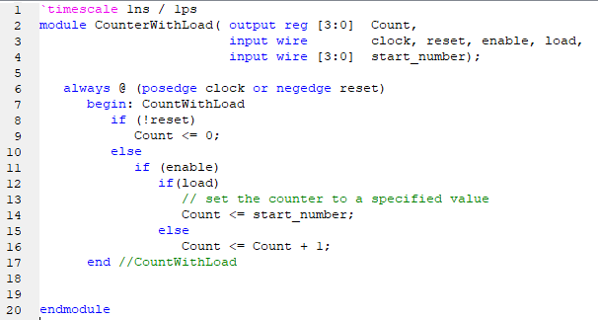

Slide 8
Where do other languages fall short?
(System)Verilog, VHDL?
Very verbose
No defence against incorrect hardware

Slide 9
Where do other languages fall short?
(System)Verilog, VHDL?
Very verbose
No defence against incorrect hardware
Embedded Generation Languages (Chisel in Scala, SystemC in C++)?

Slide 10
Where do other languages fall short?
(System)Verilog, VHDL?
Very verbose
No defence against incorrect hardware
Embedded Generation Languages (Chisel in Scala, SystemC in C++)?
Suffer under parent language Syntax
Little defence against incorrect hardware
No hardware-specific IDE support

Slide 11
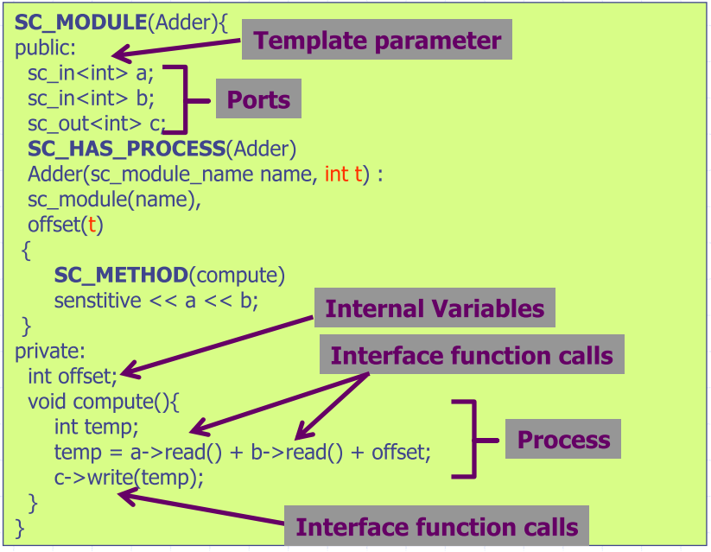

Slide 12
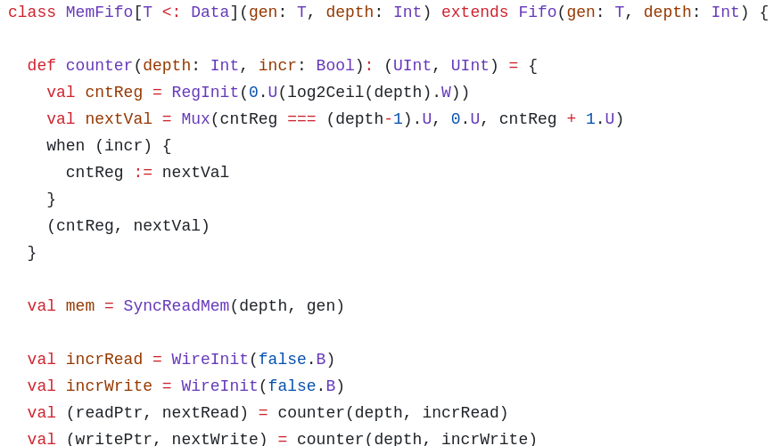

Slide 13
Where do other languages fall short?
(System)Verilog, VHDL?
Very verbose
No defence against incorrect hardware
Embedded Generation Languages (Chisel in Scala, SystemC in C++)?
Suffer under parent language Syntax
Little defence against incorrect hardware
No hardware-specific IDE support
Notes:
Turing-complete generative code?
Too high a price to pay. Basic for loops and conditions are enough in 99% of cases.
Regardless, for complicated generative code people build separate IP generators.

Slide 14
Where do other languages fall short?
(System)Verilog, VHDL?
Very verbose
No defence against incorrect hardware
Embedded Generation Languages (Chisel in Scala, SystemC in C++)?
Suffer under parent language Syntax
Little defence against incorrect hardware
No hardware-specific IDE support
HLS?

Slide 15
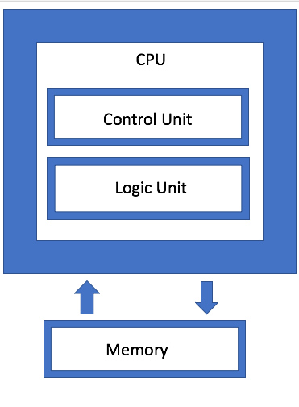
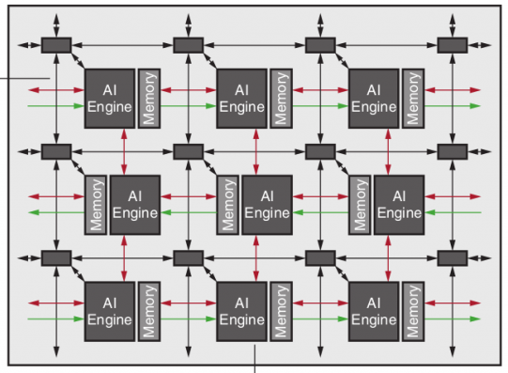
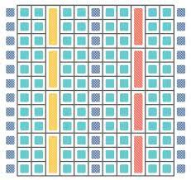
Computation
Data movement
Timing Details
HLS: We can do it all!

Slide 16

C++

Slide 17


pointers
RAII
Recursion
memory allocation
IO
C++

Slide 18
“ It improves portability ”
“ Single-source host and kernel ”
“ The compiler will figure it out ”
“ Turn software devs into hardware devs ”
C++
HLS

Slide 19
Where do other languages fall short?
(System)Verilog, VHDL?
Very verbose
No defence against incorrect hardware
Embedded Generation Languages (Chisel in Scala, SystemC in C++)?
Suffer under parent language Syntax
Little defence against incorrect hardware
No hardware-specific IDE support
HLS?

Slide 20
Where do other languages fall short?
(System)Verilog, VHDL?
Very verbose
No defence against incorrect hardware
Embedded Generation Languages (Chisel in Scala, SystemC in C++)?
Suffer under parent language Syntax
Little defence against incorrect hardware
No hardware-specific IDE support
HLS?
Lose control over generated hardware (Are you sure it’s optimal?)
(Corporate HLS) is not portable at all, and stifles lower-level access for competitors

Slide 21
Where do other languages fall short?
(System)Verilog, VHDL?
Very verbose
No defence against incorrect hardware
Embedded Generation Languages (Chisel in Scala, SystemC in C++)?
Suffer under parent language Syntax
Little defence against incorrect hardware
No hardware-specific IDE support
HLS?
Lose control over generated hardware (Are you sure it’s optimal?)
(Corporate HLS) is not portable at all, and stifles lower-level access for competitors
Other NeoHDLs (Filament & Spade)?

Slide 22
Where do other languages fall short?
(System)Verilog, VHDL?
Very verbose
No defence against incorrect hardware
Embedded Generation Languages (Chisel in Scala, SystemC in C++)?
Suffer under parent language Syntax
Little defence against incorrect hardware
No hardware-specific IDE support
HLS?
Lose control over generated hardware (Are you sure it’s optimal?)
(Corporate HLS) is not portable at all, and stifles lower-level access for competitors
Other NeoHDLs (Filament & Spade)?
Focus on Correctness
Focus on Timing

Slide 23
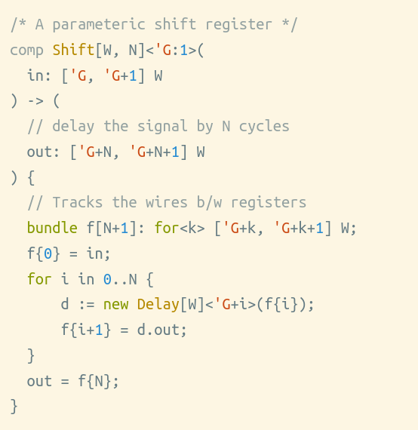
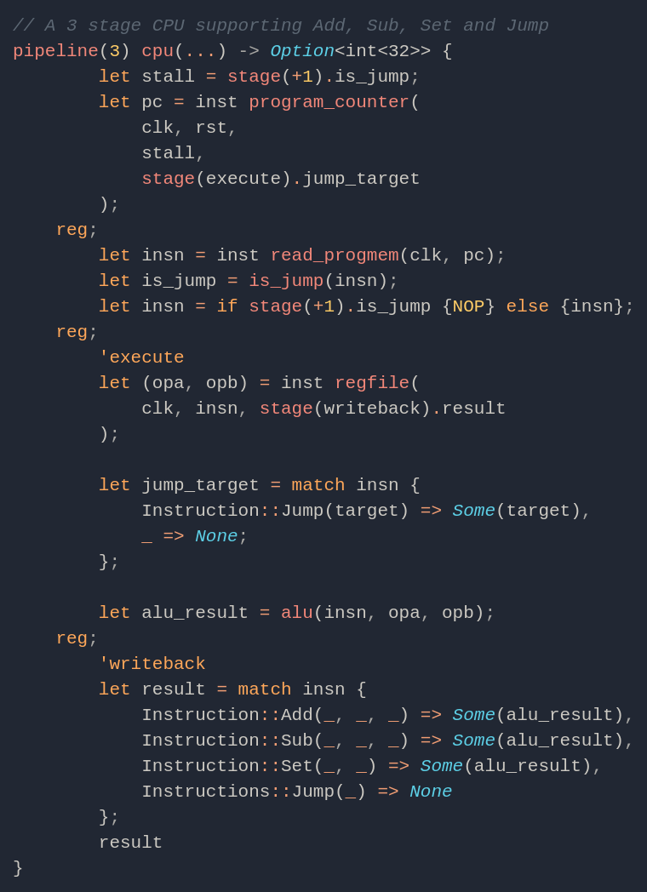

Slide 24
Hot Takes

Slide 25
Hot Takes
There are no reusable hardware components
Software prototyping for hardware doesn’t exist (unless it’s named Verilator)
HLS is not the solution

Slide 26

So… Abstraction Bad?
Of course not.
Abstraction Good!

Slide 27
Good Abstractions
Bad Abstractions
Represent the programmer’s intent
Replace error-prone constructs
Don’t get in the way
⇒ Reduce Designer mental load
Trade in design freedom for “abstraction”
⇒ Contort the Designer into the vendor’s paradigm

Slide 28
SUS Design Process

Slide 29



Control
Feedback
Pragmatism
Notes:
Design decisions shouldn’t just be logically correct, but intuitively make sense.

Slide 30
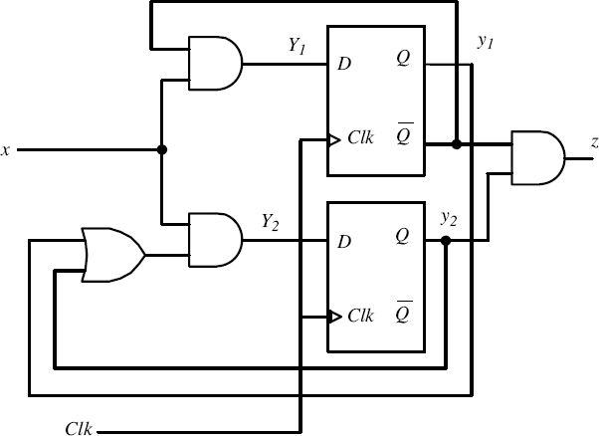
Control
If I can draw it, I want to be able to write it
⇒ All synchronous hardware representable
Notes:
“No spooky action at a distance”
“No implementation Mystery”

Slide 31
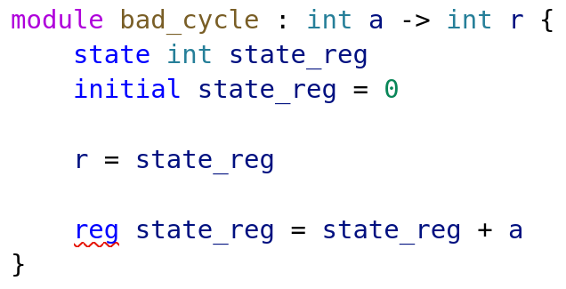

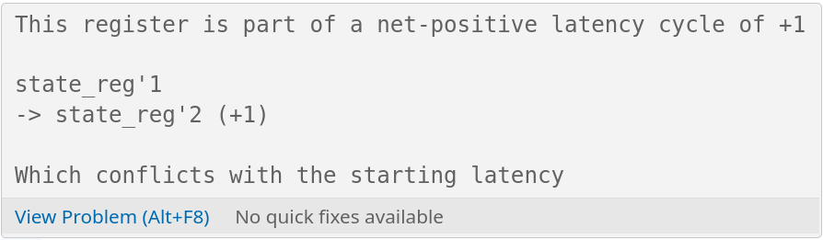
Feedback
LSP
Errors & Info
Navigation
Code Suggestions
Instant In-Editor Feedback
No separate Compile Step
Notes:
Example: C++ Templates as bad for feedback

Slide 32
Pragmatism
Let hardware be hardware
Simple things should be simple
Infer where possible
Notes:
The most floaty of the three
Every word counts
Simplicity in Syntax and Editing
Inference is powerful!

Slide 33
Pragmatism
Let hardware be hardware
Simple things should be simple
Infer where possible beneficial
Notes:
The most floaty of the three
Every word counts
Simplicity in Syntax and Editing
Inference is powerful!

Slide 34
Examples

Slide 35
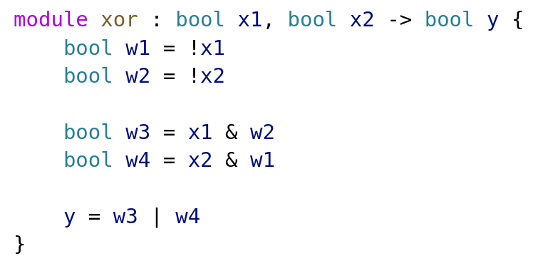
XOR gate
Notes:
SUS is a Structural Language
SEMANTICS

Slide 36
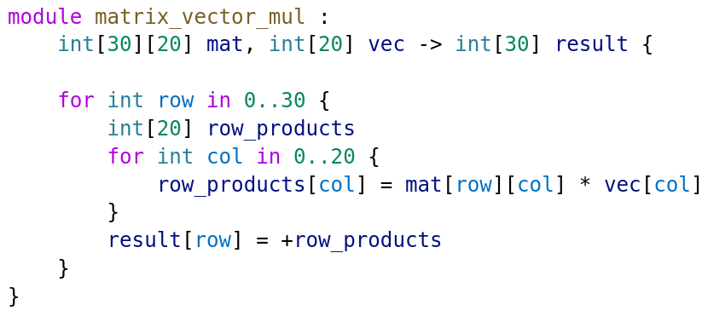
Generative Code
Notes:
For loops are always generative
GENERATIVE SEMANTICS

Slide 37
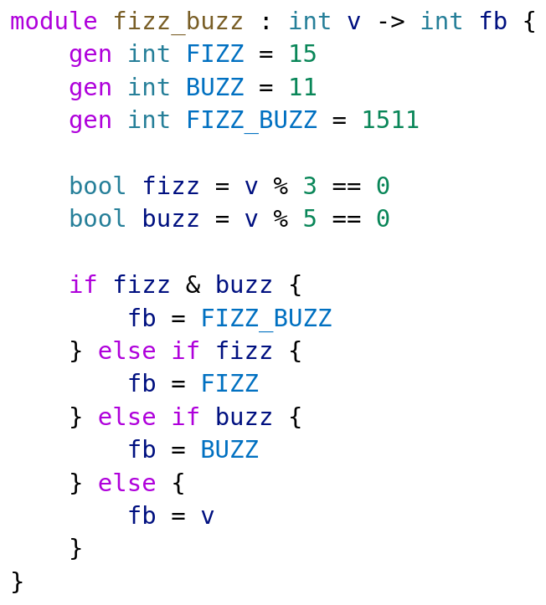
FizzBuzz

Slide 38
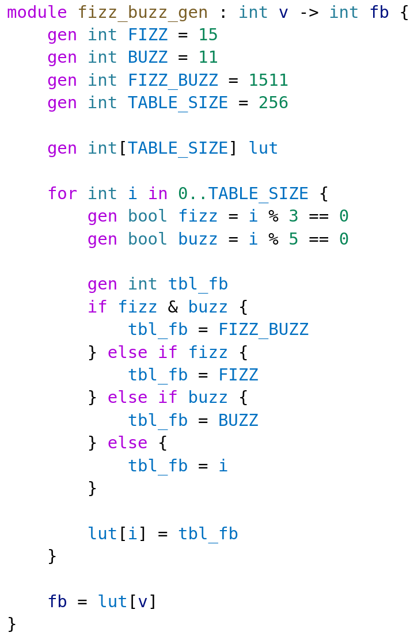
Generative FizzBuzz

Slide 39
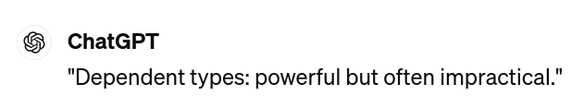
Dependent Types!
Notes:
Values are Values and Types are Types, and never the twain shall meet!

Slide 40
Typing

Slide 41
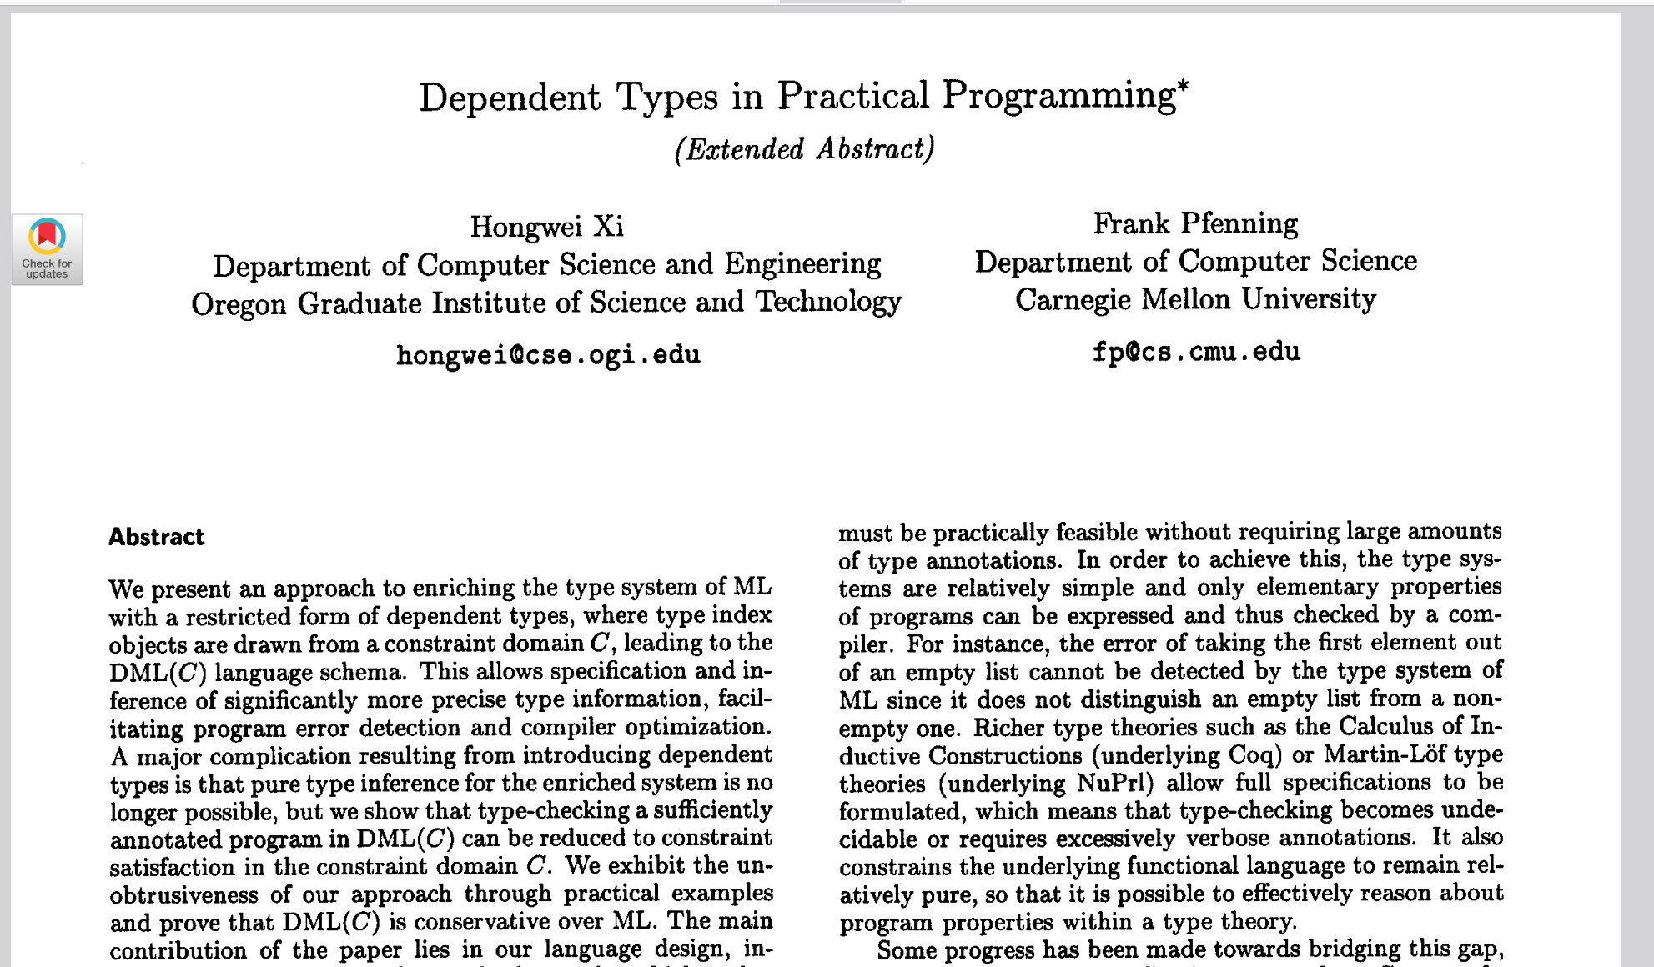

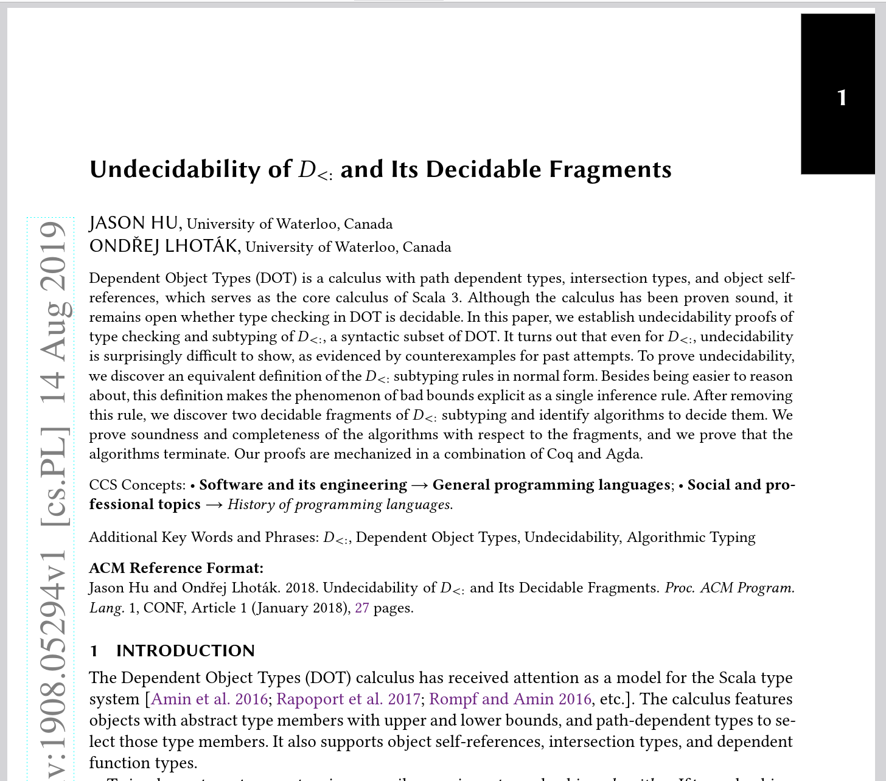
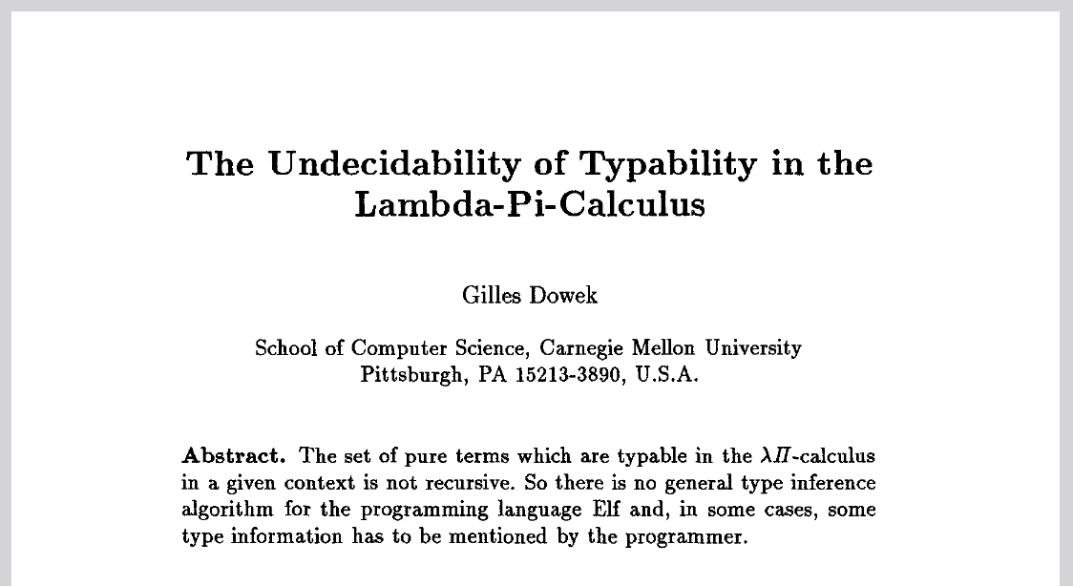
Dependent Types are a nightmare to work with
Notes:
You could fill a library with all the papers in Dependent Types

Slide 42
What is the SUS-lution?
Want simple type checking → use dynamic typing?
Want to use type info to hint user at template level → traits & types?
But do we really need to statically prove all parametrizations of a module are “correct”?
Or can we simply check each instance?
Does this info need to care about array sizes?
⇒ Two typing levels!
Notes:
It picks the pragmatic solution

Slide 43
Abstract Type
Concrete Type
int[]
Typecheck at Flattening time
Only type names and structure
LSP Info & Template checking
int[256]
Typecheck at Instantiation time
Type names and concrete values
Actually define wires

Slide 44
Latency Counting

Slide 45


Registers
Notes:
State & Latency regs
Distinction is intention
State: clock cycles in logic function
Latency: pipelining/meeting timing
SUS creates a major abstraction by dividing the registers in two categories. State and latency registers. The distinction is programmer intention:
State registers are for when you want to move data across clock cycles as part of the logic’s function.
Latency registers are purely for pipelining and meeting timing. In the rest of the slides, state registers are blue, and latency registers yellow.

Slide 46
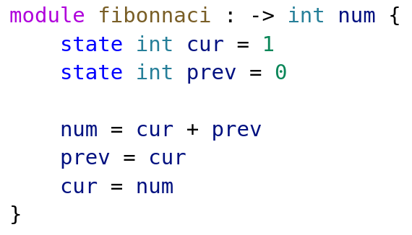
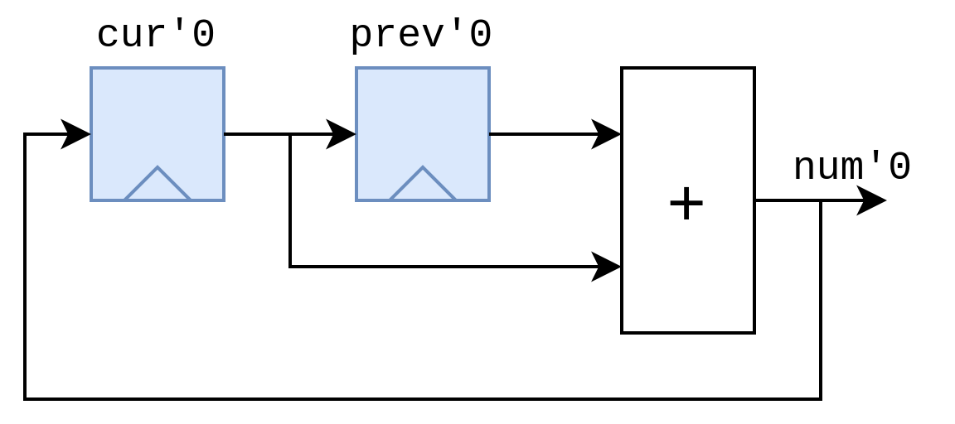
State registers
Notes:
Just state, same as normal
one elem per clock
explicit use of regs in logic
Here is a small example of just state registers. State registers are exactly the same as you would find in other HDLs like Verilog or VHDL.
This fibonacci module generates the sequence one element per clock cycle.
In this example we explicitly want to move data across clock cycles as part of the design’s functioning.

Slide 47
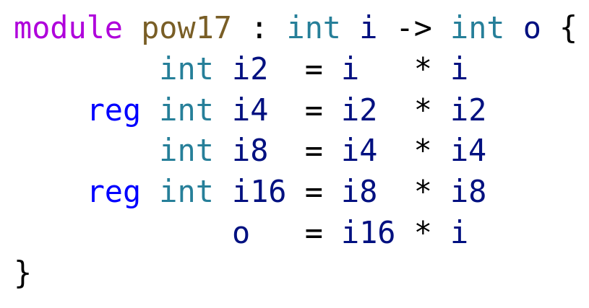
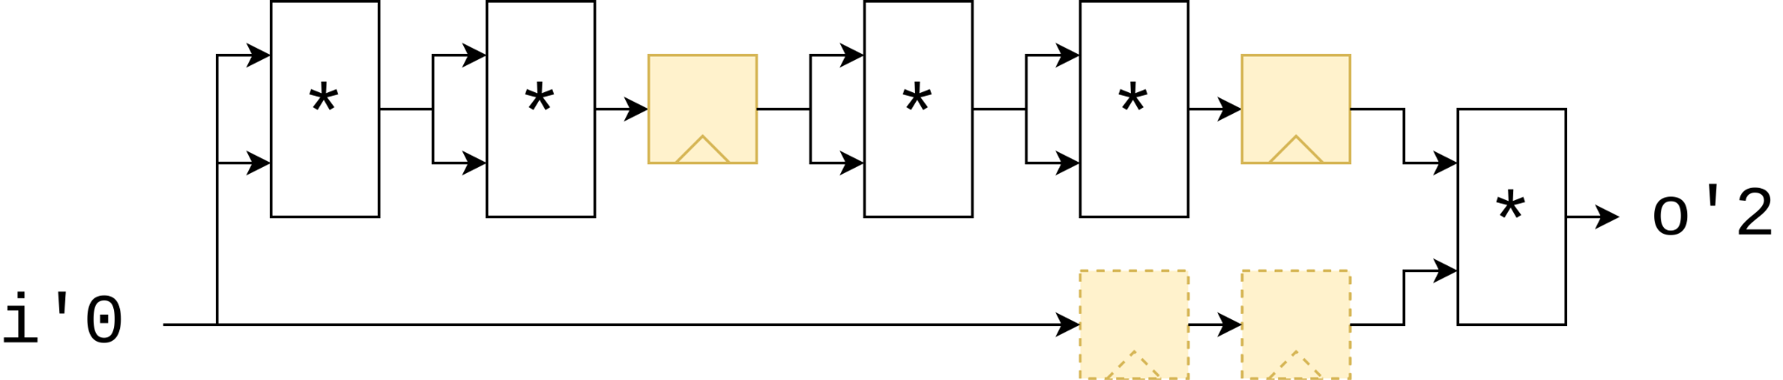
Latency Registers
Notes:
Latency used timing
Not allowed to affect functionality
17th pow i
i*i 4 times
multiply by original
add latency on one branch, compiler adds to sync
Most languages support this
Latency registers on the other hand, are exclusively used to meet timing. They are not allowed to affect the functionality of the design. (aside from the added latency of course).
In this case, we have a module that computes the 17th power of i. It multiplies i with itself four times, and then multiplies the original with that. We add some latency registers here and the compiler automatically adds extra registers to keep everything in sync.
It is implemented by keeping track of a value called “absolute latency”, which is increased for every latency register the code passes. That’s the number after the quote.
So far so good, this is a feature most pipeline design languages support.

Slide 48
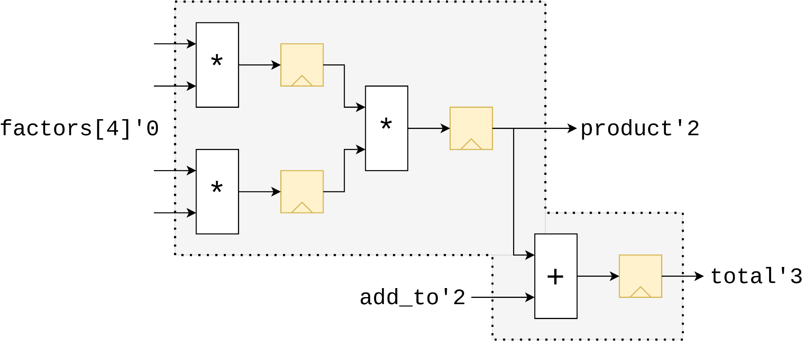
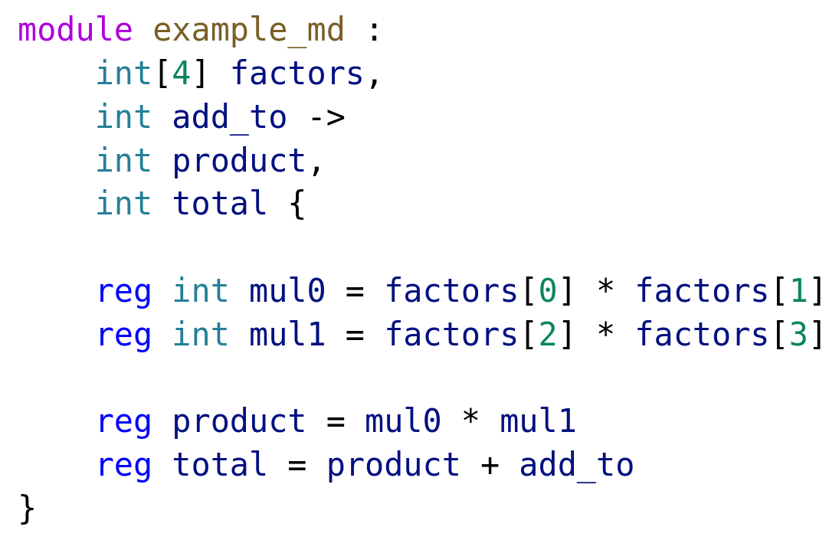
Port Latencies
Notes:
Design freedom -> ports differ latencies
factor list is 0, add_to 2 and so on
differences in port latencies used for counting for modules using it
latencies don’t need be specified, Latency Count infers them
inference makes latency count not as trivial as at a glance
To allow as much design freedom as possible, SUS allows ports to be at different latencies. For example in this case the factors list is at Absolute Latency 0, add_to 2, and so on. When the module is instantiated the port latencies are used in the parent module.
These latencies don’t need to be specified, as a big part of Latency Counting is inference of them. But this inference makes latency counting not as trivial of a problem as it might seem at first glance. What is important to see here is that any module has only one correct canonical representation.

Slide 49
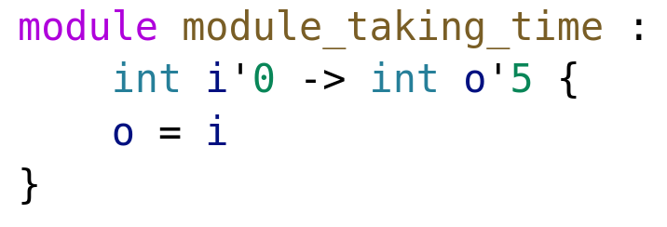
Latency Annotations
Notes:
Possible to override inferred
Forced to instantiate 5
ordinarily wire
It is however possible to override the inferred latencies with custom ones, as in this example. Here it is forced to instantiate 5 registers, where it would have ordinarily been a wire.

Slide 50
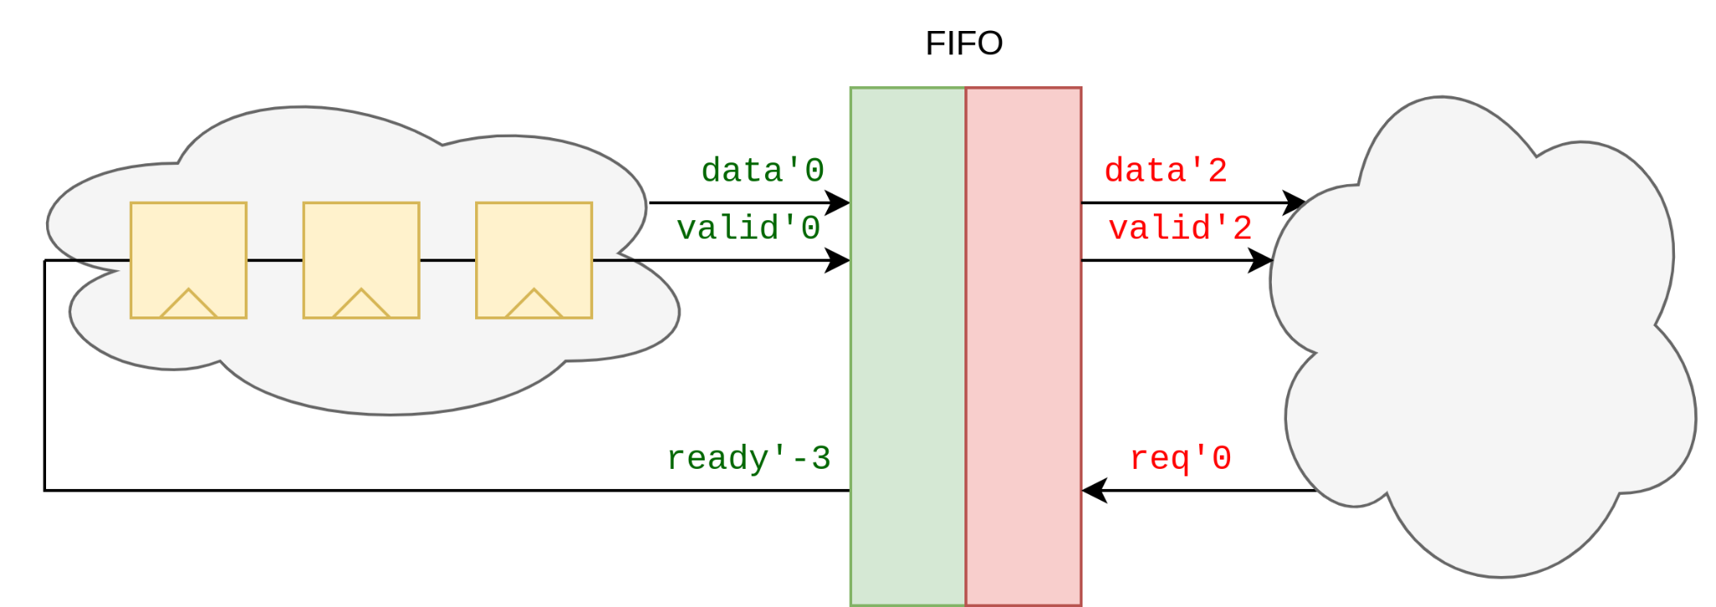
Multiple Interfaces
Notes:
Multiple interfaces
Each has latency “origin”
Interfaces are independent
Ports on write are “correlated”, no direct connection to read side
Modules can have multiple interfaces, each of which has its own latency ‘origin’. Interfaces are independent. Like in this example, all ports on the write side of the fifo are “correlated”, but they don’t have a direct connection to the ports in the read side.

Slide 51
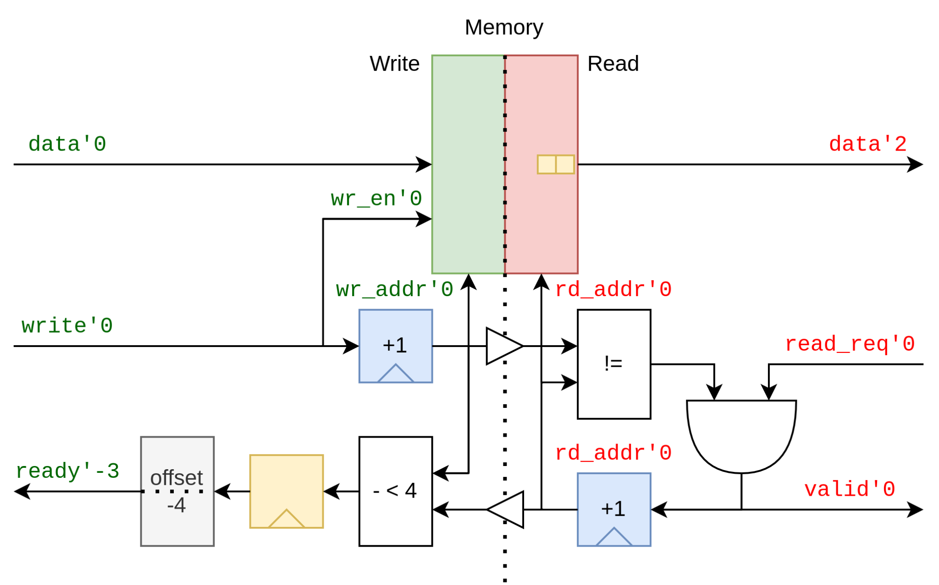
Latency Cuts
Notes:
FIFO Impl
Can see two interfaces
barrier shown triangles
no latency info carried
allow slack for user code
more interesting things:
added latency shows possible to combine
offset by -4 to allow write slack
crossing and offset are “breaking out”
Similar to Clock Domain Crossing - SUS way of CDC
Diving into the FIFO implementation, we can distinctly see the two interfaces. When crossing an interface barrier, as shown with the white triangles, no latency information is carried over.
This FIFO allows for four cycles of delay between the ready and write ports, to allows some slack for the data provider’s implementation.
There’s several more interesting things in this image. For example we added a latency stage to the ready port, because this comparison could be expensive. Crossing the interface barrier is kind of breaking out of the latency counting system though, as is the offset -4 block.
Finally you can notice that this is very similar to a clock domain crossing. In fact, interfaces are the place where clock domain crossings are done in SUS.

Slide 52
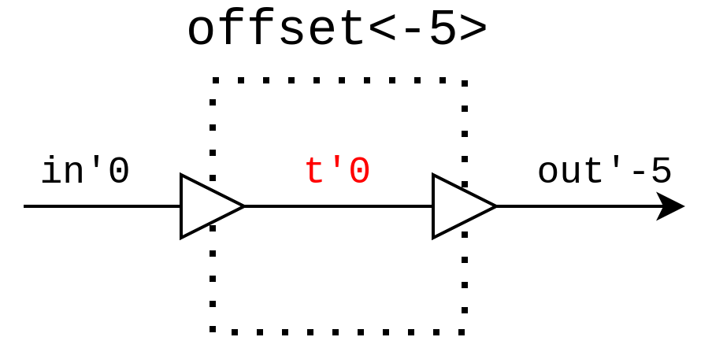
Latency offsets
Notes:
Offset impl using latency cuts
anonymous interface
As an aside, it’s actually possible to implement latency offsets using only latency cuts. Simply pass the data through an anonymous interface and back.

Slide 53
Architecture & Future

Slide 54
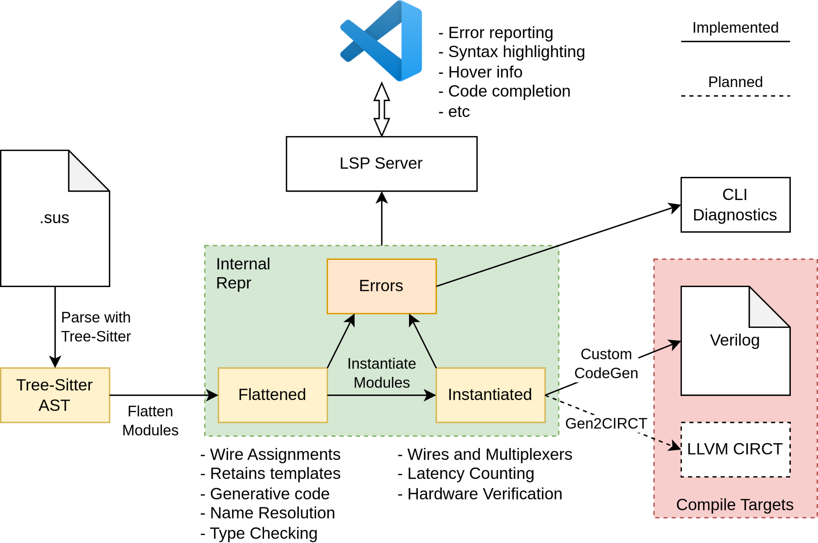
Architecture

Slide 55
Short term milestones “Build anything in SUS”
Arbitrary Single-Clock hardware description
Migrate from custom parser to Tree-Sitter
Multi-interface modules
Integer Bounds
Templates & Generative Parameters
Standard Library
Extern (Verilog) Modules
Implement FIFO, Memory Block, Skid Buffer, Distributor, Merger, etc

Slide 56
Vague long term milestones
“SUS stands for Safety”
CIRCT Compile Target
Enables use of btor2 LTL for verification
Advanced Bounds
Use Bounds system as an alternative to Sum Types
Protect FIFOs, skid buffers, etc in the STL using LTL verification
Arbitrary Multi-Clock hardware description
STL Clock Domain Crossing modules
Multi-Clock STL modules
Inference of generative parameters
Custom Types

Slide 57
LSP Demo

Slide 58


github.com/pc2/sus-compiler
Notes:
thank
LC small part of SUS
more to discuss, all I have time
such as inferring submodule latencies
Right then, I hope you all enjoyed my talk. Of course latency counting is only a small part of the SUS compiler, and there’s much much more to discuss, but this is all I have time for.

Slide 59
Are “traits” reasonable for hardware?
C-style types vs Rust-style types?
Type inference?
Additional Constructs: first, only, chain?
Backend?
Abstraction for valid/reset protocols?
Built-in Verification?
Bounded integers vs bitwidths?
Integer representations? (2s cpl, vs 1s cpl vs one-hot vs registered)
Built-in Floats?
Sum Types?
Latency offsets within structs?
What becomes of SUS after I graduate?

